Slide 1

EMBSYS 105 Programming with Embedded & Real-Time Operating Systems
Instructor: Nick Strathy, nstrathy@uw.edu
TA: Gideon Lee, gideonhlee@yahoo.com
© N. Strathy 2020
1/6/2020

Slide 2




Introductions

Slide 3
Course requirements
Participation - must attend at least 6 of the 10 lectures
Attendance is verified using a weekly class quiz which does NOT count for your grade
60% for 5 assignments (individual effort)
40% for course project (individual effort)
Don’t post solutions in the discussion forum
Using code that you find on the web is fine – just mention your source.

Slide 4
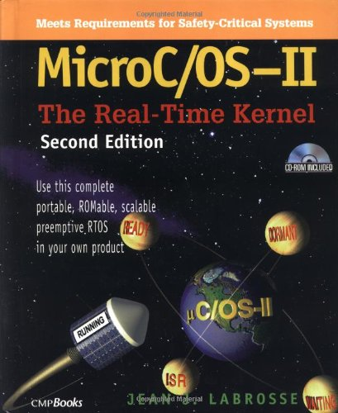
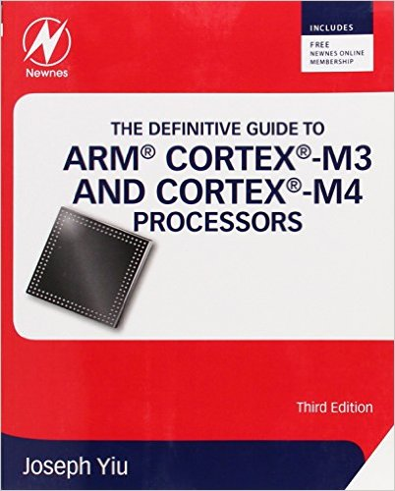


Textbooks
Required
MicroC/OS-II The Real-Time Kernel, Second Edition, 2002, Jean J. Labrosse. The PDF is available online: https://doc.micrium.com/download/attachments/10753158/100-uC-OS-II-002.pdf
The Definitive Guide to ARM Cortex-M3 and Cortex-M4 Processors 3rd ed., Joseph Yiu, Elsevier, 2014.
Useful for reference
An Embedded Software Primer, David E. Simon, Addison-Wesley 1999
Modern Operating Systems Fourth Edition, Andrew S. Tanenbaum, Herbert Bos, Prentice Hall, 2014

Slide 5
Looking ahead
Assignments are due Sundays
1/12/2020 11:59 PM Assignment 1 due
We have two holidays:
January 20 no class
February 17 no class
Please make sure your Canvas settings are configured to receive email announcements and discussions for this course

Slide 6
Handy page of reference links on Canvas
https://canvas.uw.edu/courses/1347174/pages/embsys-105-resources
Contains
Links to the reference documents for this course
Link to the version of IAR EWARM for this course:
https://1drv.ms/u/s!Ahm13wmWGad-jCcuCl4eTXwHQ5iQ?e=6eFvZy
Notes:
CORRECTION: LPC2478STK corrected to LPC2378STK

Slide 7
EMBSYS 105 Goals
Embedded Operating Systems
Port MicroC/OS-II to the NUCLEO-F401RE development board
Program a multitasking system
Develop event-driven systems
Develop hardware/software APIs
Device Drivers
Use a device driver framework
Understand and use a standard device driver API
Course Project
Put it all together to document, design, develop, test and debug an MP3 player.
Notes:
CORRECTION: LPC2478STK corrected to LPC2378STK

Slide 8
Week 1 Overview
Embedded Operating System Concepts Part 1 (Labrosse Chapter 2)
Foreground/Background Systems
Shared resources
Critical sections
Multitasking
Tasks
Context switching
ARM Review (Yiu Chapters 4, 8)
States and Modes
Registers
Assembly language instructions
Interrupt semantics
Assignment 1 – uDebugger tool (due in 1 week)

Slide 9
Embedded operating system concepts
What is an operating system (OS)?
Fundamentally it provides a layer of software abstraction above the hardware
i.e. provides a set of software interfaces between applications and the hardware

Slide 10
Embedded operating system concepts
Before we get to Embedded OSes, what is a “Platform OS”?
Examples: Linux, Mac OS X, Windows, etc.
General purpose platform for application programs to run on
File system
Multitasking
Memory management
Security – user mode vs kernel mode
etc.
Cost of generality/flexibility: no hard timing guarantees

Slide 11
Embedded operating system concepts
An Embedded OS is some subset of a Platform OS
Features of the OS are restricted by
Limited hardware – small memory, small processor, limited I/O capabilities, etc.
Only a narrow range of functionality is required for such devices as thermostat, microwave oven, wrist watch, etc.
Hard real time commitments may be required
Requires a real-time OS
Guaranteed interrupt latency
Examples: medical devices, flight controls, antilock brakes, etc.

Slide 12
Embedded operating system concepts
Example: Foreground/Background OS
A simple embedded OS
The OS is modeled by two components, a “foreground” and “background” component
The background component consists of a “super loop” that runs the ongoing monitoring and functionality of the system in an infinite loop
The foreground component consists of interrupt service routines (ISRs) that provide timely responses to external inputs
In the simplest case where nested interrupts are not supported we have at most 2 “threads of execution” – the background thread and the foreground (ISR) thread.

Slide 13
Embedded operating system concepts
Foreground/Background OS example: Thermostat
Super loop runs in background, interrupt service routines run in foreground
uint32_t currentTemperature;
uint32_t temperatureSetting;
while (1) { /* super loop - runs in background */
/* update currentTemperature from sensor */
/* update display from currentTemperature */
/* update display from temperatureSetting */
/* update heater on/off signal */
}
ISR_ButtonUpArrow { /* runs in foreground */
temperatureSetting++;
}
ISR_ButtonDownArrow { /* runs in foreground */
temperatureSetting--;
}

Slide 14
Embedded operating system concepts
Shared resource problems in multithreaded systems
Any system that allows interrupts can have multiple threads of execution
Problems can easily arise when multiple threads access the same resource e.g. global variable race conditions
The integrity of the shared resource can be corrupted if interrupts occur while multiple threads are operating on the shared resource
Thermostat example
Shared resource: temperatureSetting (global variable)
Say we want to enforce a saturation value of 90 degrees on temperatureSetting to prevent it from being set any higher
Need to correctly handle updates on the temperatureSetting global variable
Let’s look at a wrong way of handling the updates …

Slide 15
Embedded operating system concepts
Example of buggy update of a shared resource
The intention was to stop temperatureSetting from exceeding 90
uint32_t temperatureSetting;
uint32_t i;
while (1) {
if (temperatureSetting == 91) {
for (i=10000;i;i--); /* artificial delay */
temperatureSetting = temperatureSetting - 1;
}
}
ISR_ButtonUpArrow { /* runs in foreground */
temperatureSetting++;
}
If the setting happens to be 90 and we click the up-arrow button rapidly we can in principle interrupt the if block three times in quick succession and increment the setting up to 92. We’ve even added an artificial delay to make sure it happens!

Slide 16
Embedded operating system concepts
A fix for this instance of buggy resource sharing
uint32_t i;
while (1) { /* super loop */
if (temperatureSetting == 91 > 90) {
for (i=10000;i;i--); /* artificial delay */
temperatureSetting = temperatureSetting - 1;
temperatureSetting = 90;
}
}
ISR_ButtonUpArrow { /* runs in foreground */
temperatureSetting++;
}
however this problem and its solution are ad hoc, so …
Now, even though the if block gets interrupted it will always ensure that the setting is 90 or less.

Slide 17
Embedded operating system concepts
Let’s get more formal about handling shared resources.
Critical section:
Definition: a critical section is a section of code that accesses a shared resource and may be executed by only one thread at a time.
Critical sections are said to be atomic, meaning a CS cannot be executed by more than one thread at a time.
A CS enforces mutual exclusion meaning any thread executing in a CS excludes all other threads from entering the CS.
Even if a thread is interrupted during a critical section, no other thread may enter the CS until the first thread has resumed and exited it.

Slide 18
Embedded operating system concepts
Example of code that requires a critical section
Code that may be executed by multiple threads and accesses a shared resource needs to be thread safe
int gCount = 0; // global var
...
// should be in a critical section:
gCount++;

Slide 19
Embedded operating system concepts
Some ways of enforcing mutual exclusion in critical sections
Disable interrupts: this is the easiest way and is fine if critical sections are short and don’t interfere with real time constraints.
int gCount = 0; // global var
...
disableInterrupts(); // call a function that disables interrupts
gCount++;
enableInterrupts(); // call a function that enables interrupts

Slide 20
Embedded operating system concepts
Some ways of enforcing mutual exclusion in critical sections
Test-and-set
To enter the CS, a thread polls a shared variable x whose default value is 0
Any thread desiring to enter the CS should only do so if x==0
If x==0, the thread sets x=1 and enters the CS otherwise tries again later
On exit from the CS the thread sets x=0
Problem: the thread can’t get interrupted between testing and setting
Typically implemented at the assembly language level using an atomic SWAP instruction (ARM7 provides SWP – swap a word from memory with a register without interruption)

Slide 21
Embedded operating system concepts
Some ways of enforcing mutual exclusion in critical sections
Sample critical section code using test-and-set “spin lock”
int gCount = 0; // global var to be protected
int gTSLock = 0; // global test-and-set lock var
...
while (testAndSet(&gTSLock) != 0) { /* spin */ };
// if we arrive here we are in critical section
gCount++;
gTSLock = 0;

Slide 22
Embedded operating system concepts
Some ways of enforcing mutual exclusion in critical sections
test-and-set implementation using swap instruction (not on Cortex-M)
/* uint32_t testAndSet(uint32_t *gTSLock) */
.func TestAndSet
testAndSet:
ldr r2, =1 /* get ready to swap a 1 into memory */
swp r1, r2, [r0] /* swap: *gTSLock = r2, r1 = *gTSLock */
mov r0, r1 /* r0 = previous value of *gTSLock */
bx lr
.endfunc
.end

Slide 23
Embedded operating system concepts
Some ways of enforcing mutual exclusion in critical sections
Test-and-set implementation for Cortex M4
Roughly the same sequence but more complicated to allow for a multi-processor environment
Instead the atomic swap is achieved with an instruction pair
LDREX – load exclusive – gets current lock value
STREX – store exclusive – stores value to lock and returns status

Slide 24
Embedded operating system concepts
Some ways of enforcing mutual exclusion in critical sections
Cortex-M4 does not have swap instruction. Instead: LDREX/STREX
get_lock
LDR R0, =Lock_Variable ; Get address of
; lock variable
LDREX R1, [R0] ; Read current lock value
DMB ; Data Memory Barrier, Make sure
; memory transfer completes before
; next one starts
CBZ R1, try_lock
B get_lock ; Lock was set by another task,
; try again
try_lock
MOVS R1, #1
STREX R2, R1, [R0] ; Try lock by writing 1, if
; exclusive access failed, return status is 1 and
; the write is not carried out
DMB ; Data Memory Barrier
CBZ R2, lock_done ; Return status is 0,indicates
that lock process succeeded
B get_lock ; locking process failed, retry
lock_done
BX LR ; return
Reference: https://www.arm.com/files/pdf/Cortex-M3_programming_for_ARM7_developers.pdf

Slide 25
Embedded operating system concepts
Some ways of enforcing mutual exclusion in critical sections
Semaphore (more later, but for now):
A more comprehensive thread synchronization mechanism invented by Edsger Dijkstra in the mid-1960s.
An operating system service consisting of a counter variable, a thread queue, and methods for operating on them.
The counter is initialized to 1 for a mutually exclusive critical section
If the counter is greater than 0, a thread may atomically decrement it and enter the CS
If the counter is 0, any thread wishing to enter the CS is suspended and added to the semaphore’s queue
When a thread exits the CS, it attempts to atomically increment the counter
If there are any threads in the queue, the first is resumed and enters the CS, otherwise the counter is incremented

Slide 26
Embedded operating system concepts
Some ways of enforcing mutual exclusion in critical sections
Sample critical section code using a mutual exclusion semaphore
int gCount = 0; // global var
Semaphore mySem;
…
semInitialize(mySem, 1); // initialize mySem’s counter to 1
…
semWait(mySem); // decrement mySem’s counter
gCount++; // safely update the shared resource
semSignal(mySem); // increment mySem’s counter

Slide 27
Embedded operating system concepts
Thread, Process, Task
Thread
A light weight unit of data and code that typically shares data and code with other threads
Process
a heavy weight unit of data and code found typically in a platform OS rather than an embedded OS
May spawn multiple threads of its own which execute within the process
Memory and other resources are not shared between processes
Example: a web browser application
Task
Depending on the context, either a process or a thread. In the context of this course it is a thread. MicroC/OS-II uses “task”, so we will usually use that term.

Slide 28
Embedded operating system concepts
Multitasking
A disciplined way of scheduling and switching the CPU between multiple tasks.
Same as multithreading
Simplifies the design, implementation and management of complex interconnected threads of execution

Slide 29
Embedded operating system concepts
Task
Same as thread in this course
A unit of data and code that can be scheduled to execute on the CPU
Typically, an infinite loop that handles one of the subdivisions of work in the overall embedded system. Each cycle through the loop handles one instance of the work unit after which the thread is suspended till it is needed again
Task Control Block (TCB)
The data structure used by a multitasking system to manage each task
At a minimum it contains
Stack pointer for the task’s own stack
Status of the task

Slide 30
Embedded operating system concepts
Task status (using MicroC/OS-II terminology)
dormant – in memory but not available for scheduling
ready – available for scheduling
running – has control of the CPU – only one task at a time is ever in this state on a single processor system
waiting – known to the scheduler but waiting for an event
ISR (interrupted) – was running but currently waiting for ISR to complete

Slide 31
Embedded operating system concepts
Context switching
Term for the sequence of steps for transferring control of the CPU from one task to another
Store all the registers (context) of the current task in the task’s private memory area
Restore the registers of the new task from its private memory area and resume execution of the new task.

Slide 32
Quiz and break
Do this evening’s online quiz in Canvas
Then take a brief break

Slide 33
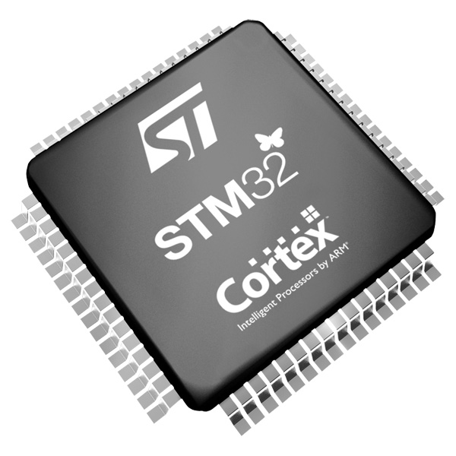
ARM Cortex-M4 review

Slide 34
ST NUCLEO-F401 development board
ST Nucleo-F401RE
LEDs
Buttons
USB
+ much more by
adding other
shields.
STM32F401RE SoC
96 kB SRAM
512 kB flash
Timers
GPIO
Interfaces
etc.
Cortex-M4 processor
ARMv7E-M arch.
NVIC
FPU
MPU

Slide 35
ARM Cortex-M4 processor
2010 original release
Three-stage instruction pipeline: fetch, decode, execute
Harvard bus architecture: instruction-fetch, data-read/write in parallel
32-bit addressing, 4GB memory space
Nested Vectored Interrupt Controller (NVIC): automatically saves a large subset of the context when handling interrupts
Thumb (16-32-bit) instruction set: denser code than ARM (32-bit-only) instruction set
Many more features
Notes:
CORRECTION: “hardware transfer level (RTL)” -> “register transfer level (RTL)”

Slide 36
Cortex-M4 States and Modes
The processor is always in one of two possible operation states, and one of two possible operation modes. Additionally, it can be in one of two access levels which controls which registers and instructions are accessible.
Operation States
Debug state: the processor is halted by the debugger after hitting a breakpoint.
Thumb state: the processor is executing instructions. It only executes Thumb (16-32-bit) instructions. Other ARM processors can execute ARM (32-bit) instructions.
Operation Modes
Handler mode: This mode is entered when an interrupt is triggered.
Thread mode: this mode is entered on reset and upon returning from an interrupt handler.
Access Levels
Privileged level: This level is always entered on reset and whenever Handler mode is entered.
Unprivileged level: this level may be entered when in privileged level however the only way to enter privileged level from unprivileged is by triggering an interrupt.
Notes:
From ARM TRM pdf

Slide 37
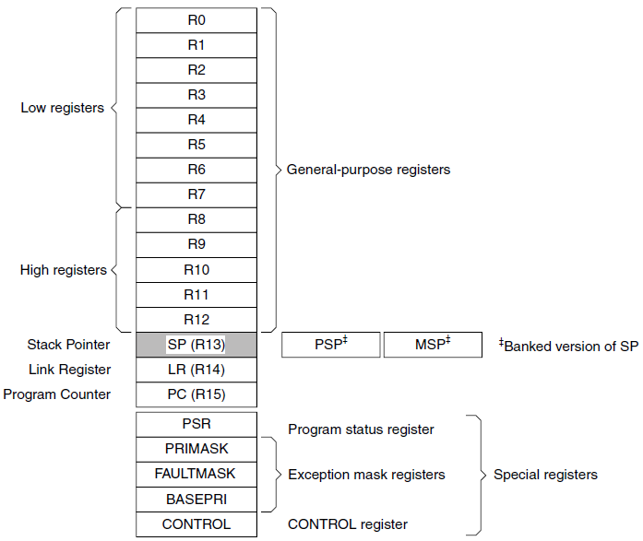
Cortex-M4 Core Registers
Source: http://www.st.com/web/en/resource/technical/document/programming_manual/DM00046982.pdf
Notes:
From ARM TRM pdf

Slide 38
Cortex-M4 Core Registers
General Purpose registers (R0-R12)
Accessible in Thread and Handler mode and privileged and unprivileged level
Stack Pointer (SP)
MSP, SP_main: accessible only in privileged level, so always accessible in Handler mode, only accessible in privileged Thread mode
PSP, SP_process: accessible in either privileged or unprivileged level. This is the stack pointer used when in unprivileged Thread mode.
Unless your application is a multi-user system you probably don’t need to run in unprivileged thread mode and thus don’t need to use SP_process.
For our applications we will only run at privileged level using the main stack pointer. This means handlers and application threads will all use the main stack pointer.
Notes:
From ARM TRM pdf

Slide 39
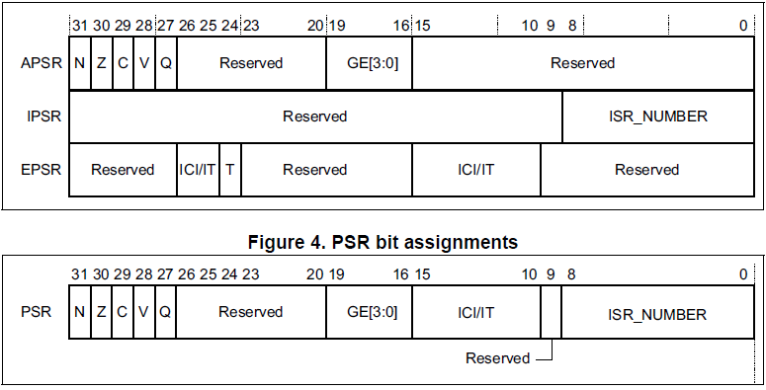
Cortex-M4 Core Registers
Source: http://www.st.com/web/en/resource/technical/document/programming_manual/DM00046982.pdf
PSR reset value: 0x01000000 which means thumb state, no interrupts active, no flags set
Notes:
From ARM TRM pdf

Slide 40
Cortex-M4 Core Registers
Exception Mask Registers (PRIMASK, FAULTMASK, BASEPRI)
Privileged level required to access
Priority Mask (PRIMASK)
1-bit: 0 means no effect, 1 means all exceptions with configurable priority are prevented. Processor faults are still enabled, eg bad memory address.
Fault Mask (FAULTMASK)
1-bit: 0 means no effect, 1 means all exceptions except for non-maskable interrupt (NMI) are prevented.
Base Priority Mask (BASEPRI)
8-bits. 0x00 means no effect, otherwise the processor does not process any exception with a priority value greater than or equal to BASEPRI.
Notes:
From ARM TRM pdf

Slide 41
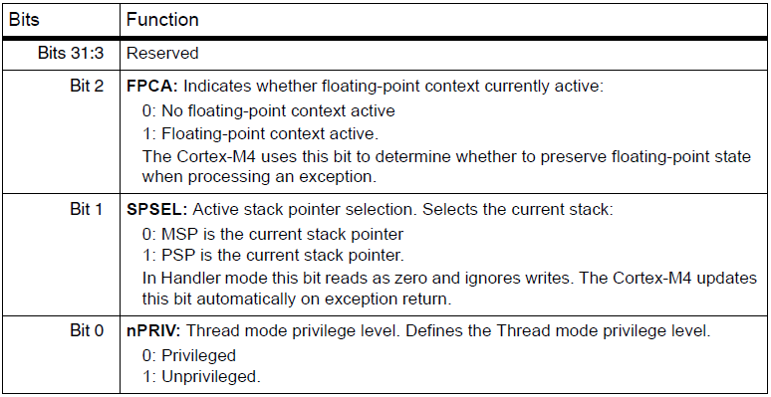
Cortex-M4 Core Registers
Control Register (CONTROL)
Privileged level required to access
Notes:
From ARM TRM pdf

Slide 42
ARMv7-M Assembly Language
Review of a subset of instructions
Moving data within the processor
Moving data to/from memory
Stack operations
Arithmetic operations
Branch instructions
Conditional execution suffixes
Notes:
From ARM TRM pdf

Slide 43
ARMv7-M Assembly Language
Moving data within the processor
MOV destination, source ; copy source to destination
MOV R0, R1 ; copy R1 to R0
MOVS R0, R1 ; copy R1 to R0, update APSR flags
MOV R7, #1 ; copy the value 1 to R7
Notes:
From ARM TRM pdf

Slide 44
ARMv7-M Assembly Language
Moving data to/from memory
LDR register, memory ; load register contents from memory
STR register, memory ; store register contents to memory
LDR R0, [R1] ; copy memory contents to R0, address is given by R1
STR R0, [R1] ; copy R0 to memory, address is given by R1
LDR R0, [R1, #4] ; address is R1+4 (pre-index), R1 is not updated
LDR R0, [R1, #4]! ; address is R1+4 (pre-index), R1 is updated to R1+4 (write back)
LDR R0, [R1], #4 ; address is R1, then R1 is updated to R1+4 after memory access (post-index)
Notes:
From ARM TRM pdf

Slide 45
ARMv7-M Assembly Language
Stack operations
PUSH {register list} ; push the list of registers to memory using SP, SP is updated
POP {register list} ; pop the list of registers from memory using SP, SP is updated
PUSH {R0-R4,R12} ; push the given registers to memory using SP, SP is updated
POP {R0-R4,R12} ; pop the given registers from memory using SP, SP is updated
STMFD SP!, {R0-R4,R12} ; equivalent to the above PUSH
LDMFD SP!, {R0-R4,R12} ; equivalent to the above POP
Full Descending stack convention is the ARM default.
Registers are stored such that higher register numbers are placed in higher memory addresses
Notes:
From ARM TRM pdf

Slide 46
STM and LDM instructions for stack operations
FD = Full Descending
STMFD/LDMFD = STMDB/LDMIA (DB = decrement before, IA = increment after)
ED = Empty Descending
STMED/LDMED = STMDA/LDMIB
FA = Full Ascending
STMFA/LDMFA = STMIB/LDMDA
EA = Empty Ascending
STMEA/LDMEA = STMIA/LDMDB
In practice anything other than full descending convention is rare!

Slide 47
Cortex-M4 Assembly Language
Arithmetic operations (add, subtract, multiply, divide)
ADD destination, operand1, operand2
ADD R0, R0, R1 ; R0 = R0 + R1
ADD R0, R1, #25 ; R0 = R1 + 25
ADDS R0, R1, #25 ; R0 = R1 + 25, then update APSR flags
Notes:
From ARM TRM pdf

Slide 48
Cortex-M4 Assembly Language
Branch instructions
B: simple branch
B MyLabel
BL: branch and link for procedure calls, return address is stored in LR
BL MyProcedure
BX: branch and exchange updates PSR, used for return from procedure/ISR
BX LR
Notes:
From ARM TRM pdf

Slide 49
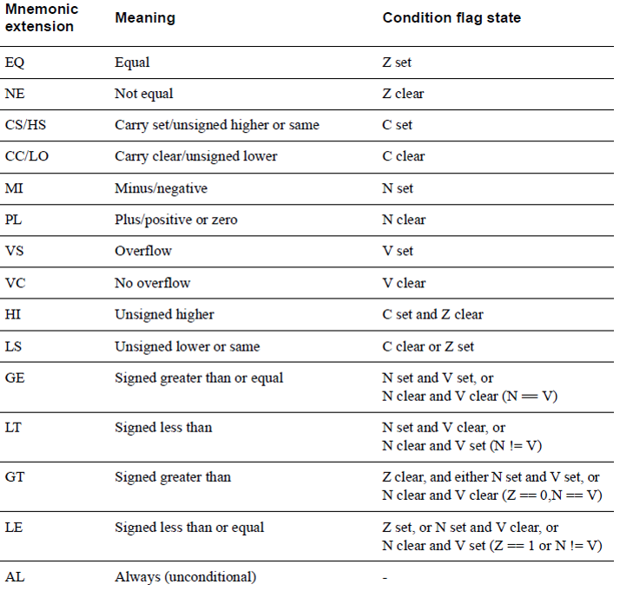
Conditional Mnemonics
Notes:
From ARM ARM pdf

Slide 50
Exception semantics
On entry to an exception the hardware is in Thumb state, Handler Mode, privileged level.
The following 8 registers are stacked using SP:
R0-R3, R12, LR, PC, PSR
Lazy stacking: if FPU is active, the FPU registers are also stacked
Return from exception is done by
BX EXC_RETURN
EXC_RETURN is the value loaded into LR on entry to the exception

Slide 51
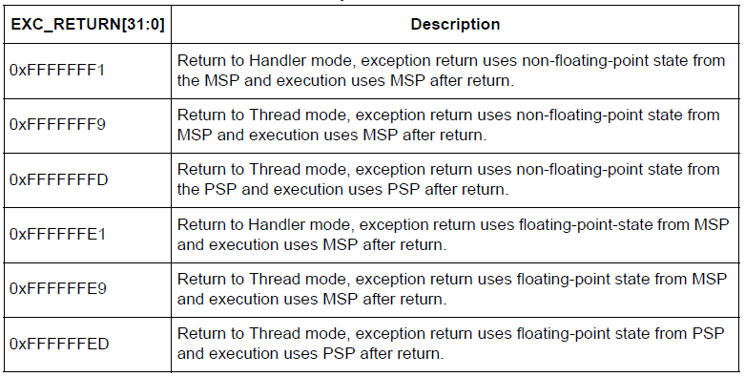
Exception semantics

Slide 52
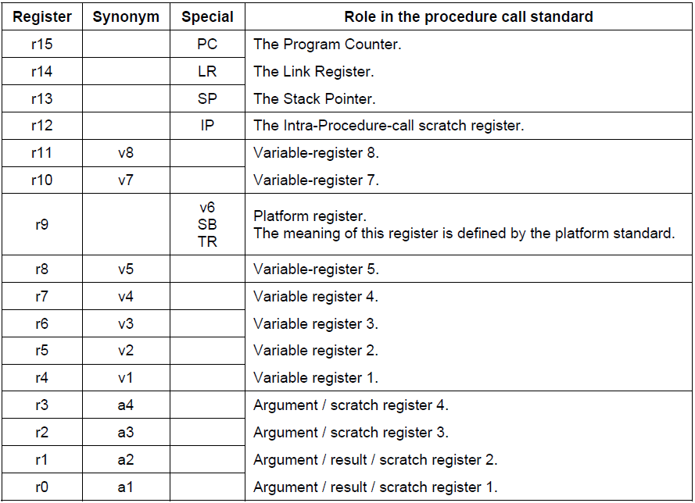
ARM procedure call standard
Notes:
From ARM Procedure Call Standard pdf

Slide 53
Review Cortex-M4 exception handling in uDebugger homework
Download uDebugger.zip
Unzip
Load the workspace into EWARM
Start up Tera Term with baud rate 38400
Run the project – notice the “Fail” message in serial terminal
Refer to the following memory map to find an invalid address to substitute in GenerateFault() in main.c
Explore the exception handler HardFaultIrqHandler in startup.s
Your assignment for next week is to fill in missing code as specified in the assignment instructions.

Slide 54
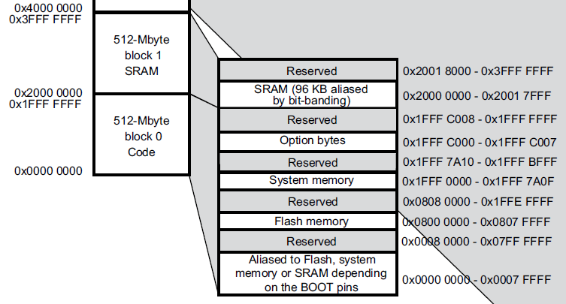
Memory Map (detail)
Source: http://www.st.com/st-web-ui/static/active/en/resource/technical/document/datasheet/DM00102166.pdf
Notes:
From ARM TRM pdf

